Slide 1
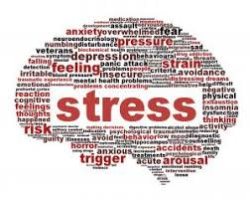
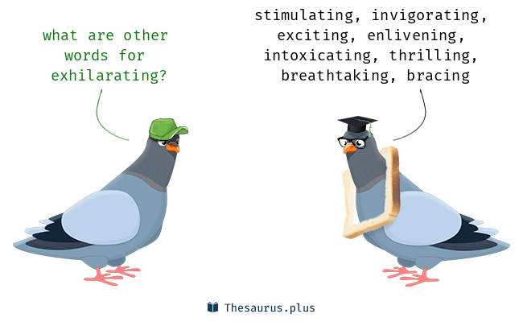
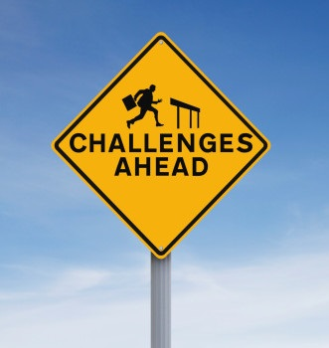
Educational
.
Stress your friend
Oxytocin
Empathy
More Social
Don’t bottle things up
Social contact and social support are vital
You have stress resilience
It makes a profound statement
You don’t have to face life’s challenges alone
Discussion
Spend time caring for others
Do you know your personal weaknesses?
Moments of joy and courage
Change your mind about stress
Heal and recover from stress induced damage
Your stress response is helpful
…
Christopher Bauman – www.chrisbauman.com.au

Slide 2
1. Can how you think about stress make you healthier? ____________________________________________________________________________________________?
Advanced Question Words
2. What do you think people find discouraging (describe) ___________________________________________________________________________________________ ?
Beliefs
Freaked me out
3. When you have stress your body is energizing ___________________________________________________________________________________________ ?
Spending energy
Non-verbal feedback
4 How can you change someone’s mind in relation to stress ___________________________________________________________________________________________ ?
Bottle up
5. When have you risen to a challenge ___________________________________________________________________________________________ ?
Demoralized
Unbeknown
Harass
6. Think of a time that you have needed to seek support ___________________________________________________________________________________________ ?
Crave
Most fascinating
7. How do you know when someone else is struggling…. How did you support them? ___________________________________________________________________________________________ ?
Friend
8. What thoughts reduce your stress / What actions reduce your stress? ____________________________________________________________________________________________ ?
Stress makes you social
What is courage? Describe an example.
Primes you
Christopher Bauman – www.chrisbauman.com.au

Slide 3
